Slide 1
Terrier Nest
Your Guide To BU Housing
Made By: Syeda & Emma

Slide 2

Problem Statement:
The Boston University on-campus housing website currently lacks crucial information for newcomers to BU and Boston. It should provide more detailed descriptions, photos, and local area guides to help students make informed housing decisions and ease their transition.

Slide 3
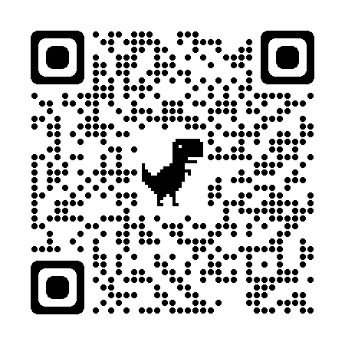
QR Code https://syedami.github.io/contact.html

Slide 4
The Solution
3.
Photo Content
1.
Verified-Reviews
5.
Utilities Information
4.
Mapping
Access real-time videos and photos that offer an authentic glimpse of what to expect in each dormitory, enhancing your confidence in your housing selection.
Gain valuable insights from verified reviews by previous residents, helping you make informed decisions about your on-campus housing choices.
Find essential information about laundry services and other utilities, ensuring that you have everything you need for a comfortable and convenient living experience.
Discover the proximity of each dormitory to BU buildings, ensuring that you're conveniently located near your classes, saving you time and reducing stress

Slide 5
What’s next?
We aim to introduce a roommate matchmaking feature, allowing users to create profiles, answer a series of questions, and receive personalized recommendations for potential roommates. This system would function similarly to popular dating apps like Tinder but with the added layer of BU authentication to ensure that users are indeed BU students. This feature will help students find compatible roommates for their BU experience.

Slide 6
Q&A

